Slide 1
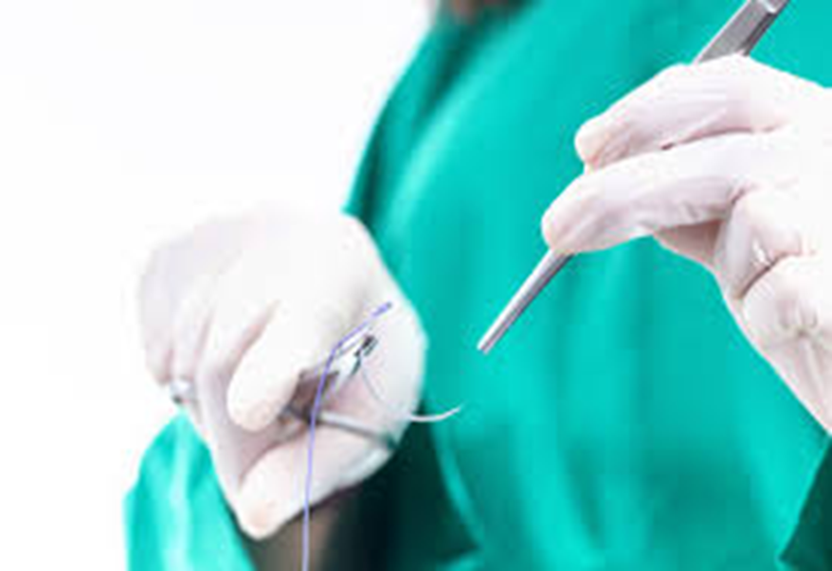
SUTURING TECHNIQUES
DR. MANASI BIRMOLE
M.B.B.S , M.S
(GENERAL SURGERY )

Slide 2
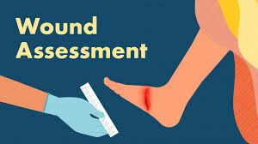
Wound assessment
Location , depth , length
Degree of contamination
Underlying structure involvement ( tendon , bone , nerve )

Slide 3
TYPES OF WOUNDS | DESCRIPTION | SUTURE USED
1. Incised wound | clean straight edge (sharp cutting edges - knife glass / metal , surgical cut ) | Absorbable / Non – Absorbable depending on location Ex – Vicryl , Nylon
2. Lacerated wound | torn irregular edges ( traumatic crushing / tearing forces) | Non – Absorbable ( Nylon , Prolene ) for skin , Absorbable for deeper layers
3. Abrasion wound | superficial scraping of the skin | Usually not needed
4.Puncture wound | deep and narrow ( nail prick ) | Not usually sutured unless large or gaping , Absorbable for deeper layers
5. Penetrating wound | Object enters body and may pass through | Layered closure with absorbable for deep tissues , Non – Absorbable for skin
6. Contusion ( BRUISE) | Blunt trauma without break in skin | NA
7. Avulsion | Tissue forcibly detached | First debridement , healing by tertiary intension

Slide 4
TYPES OF WOUND HEALING
PRIMARY INTENTION – clean wounds that are often sutured together ex- a clean cut with well defined edges .
SECONDARY INTENTION – healthy granulation tissue filling up an open wound . Ex – dog bite , severe burns , deep pressure ulcer
TERITARY INTENTION – delayed closure or skin grafting . Ex – wounds with infection .

Slide 5
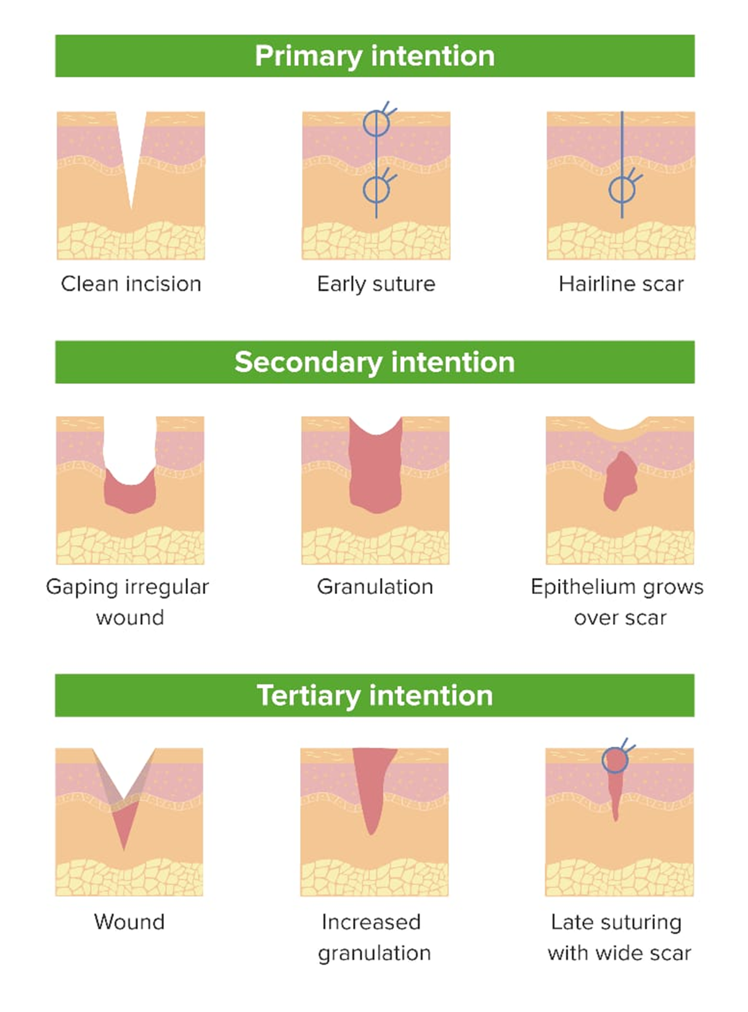

Slide 6
Aseptic preparation
Hand hygiene
Donning sterile gloves
Preparing sterile field
Cleaning and draping wound area
Use of antiseptic solutions
Tetanus toxoid

Slide 7
Preparation of surgical site
Removal of metals and other foreign bodies
Hair removal from surgical site –
the ideal time -is on the operating table .
skin clippers with disposable blades
Skin antisepsis – alcohol based antiseptic solution povidone iodine /chlorhexidine
Draping –
Drape the perimeter of the operative field using sterile drapes .

Slide 8
Wound irrigation
Triple wash
Rinse with sterile normal saline –removes dirt dead tissue debris
H2o2 wash /antiseptic wash –sterlisation
Sterile NS – Removes residual antiseptic solution .

Slide 9
Local anaesthesia
Common agents : lignocaine with / without epinephrine
Common preparation is lignocaine 2 % with adrenaline 1 : 200000
Concentration maximum volume
Plain lignocaine ( 3 mg / kg )
0.5% (05 mg / ml ) 40 ml
1 %(10 mg / ml ) 20 ml
2 % (20 mg / ml ) 10 ml
4 % (40 mg / ml ) 05 ml
Lignocaine with adrenaline 1:200000 ( 7 mg / kg )
0.5% 100 ml
1 % 50 ml
2 % 25 ml

Slide 10
Local anaesthesia
Onset and duration - rapid onset of action (30-120 minutes )
Maximum safe dose for a fit adult 7 mg / kg , when used with adrenaline safe dose increased to 500 mg – reduces the rate of absorption of lignocaine . The use of a vasoconstrictor is contra indicated for anaesthesia of fingers , toes , tip of nose , ears and penis .
Maximum safe total dose will be reduced in the following conditions : low body weight ( children ) , debility , old age , hepatic disease , renal impairment , epilepsy , heart block .
Lignocaine Toxicity :-
5μg / ml neurological symptoms – dizziness , tinnitus ,
restlessness, change in taste , neuromuscular twitches
15 μg / ml – convulsions
20 μg / ml – respiratory depression
25 μg / ml – cardiovascular collapse

Slide 11
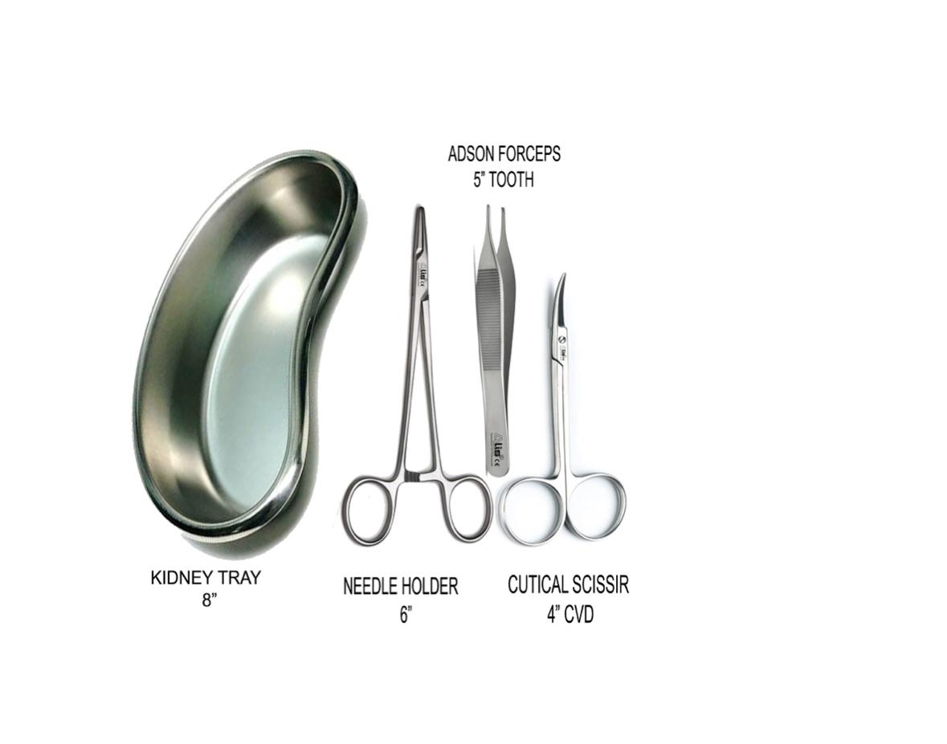
Suturing instruments
Needle holder
Forceps ( toothed or atraumatic )
Scissors

Slide 12
NEEDLE HOLDER
Two finger bows for holding
A ratchet or lock
A pair of shaft or body
Joint
Pair of blades at terminal part .
blades are smaller in comparison to shaft of the instrument .
Criss cross serrations in the blade & longitudinal groove in the centre of the serrations which allow firm gripping of the needle .

Slide 13
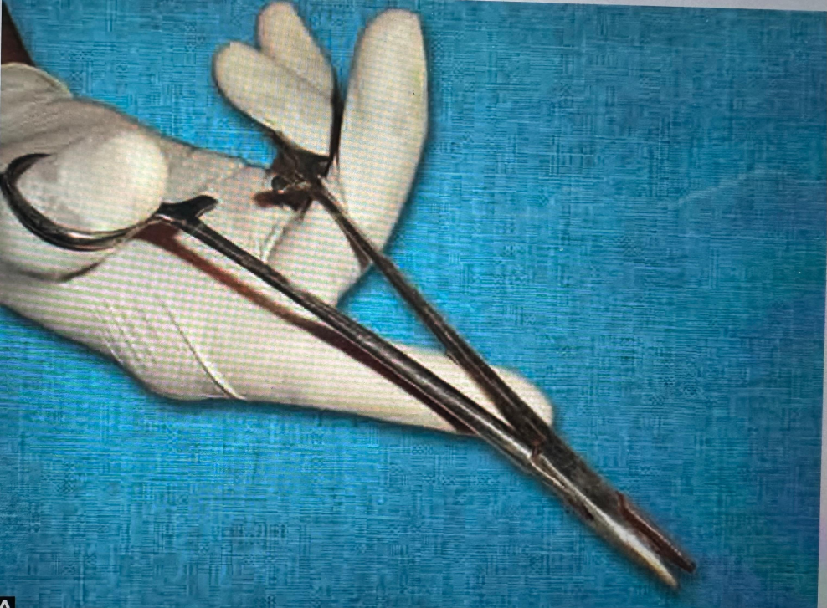
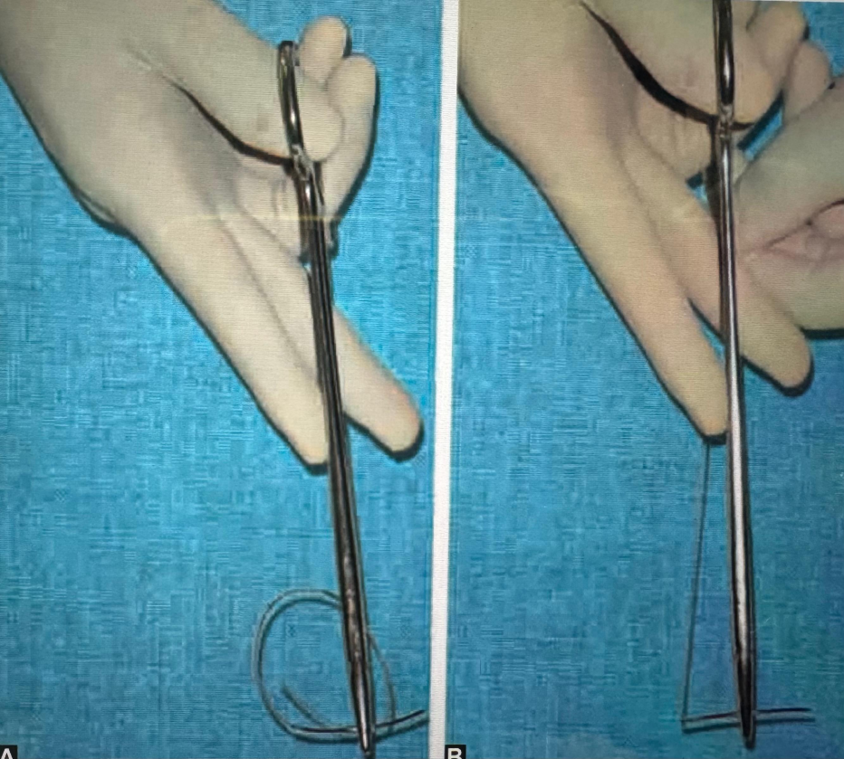
HOW TO HOLD A NEEDLE HOLDER

Slide 14
HOW TO HOLD A NEEDLE HOLDER
Thumb and ring fingers are placed in the finger bows till the distal interphalangeal joints .
Index finger is extended along the length of the handle to give direction to it .
- Needle is placed in the needle holder at the junction of proximal 2/3rd to distal 1/3rd of the needle holder for optimum grip and precision .
- Smooth rotation movement that the movement with force
- Rotation force should be in the direction of curvature of needle .
- Holding the needle tip with instrument will cause blunting or breaking of the tip .
- When both edges are held together and needle is forced through them , there are chances of having lateral movements which can cause tear at first point of entry of needle .

Slide 15
types of suturing
Simple interrupted sutures
Vertical mattress sutures
Horizontal mattress sutures
Continuous sutures
Continuous interlocking sutures
Subcuticular sutures
Skin staplers
Tissue glue

Slide 16
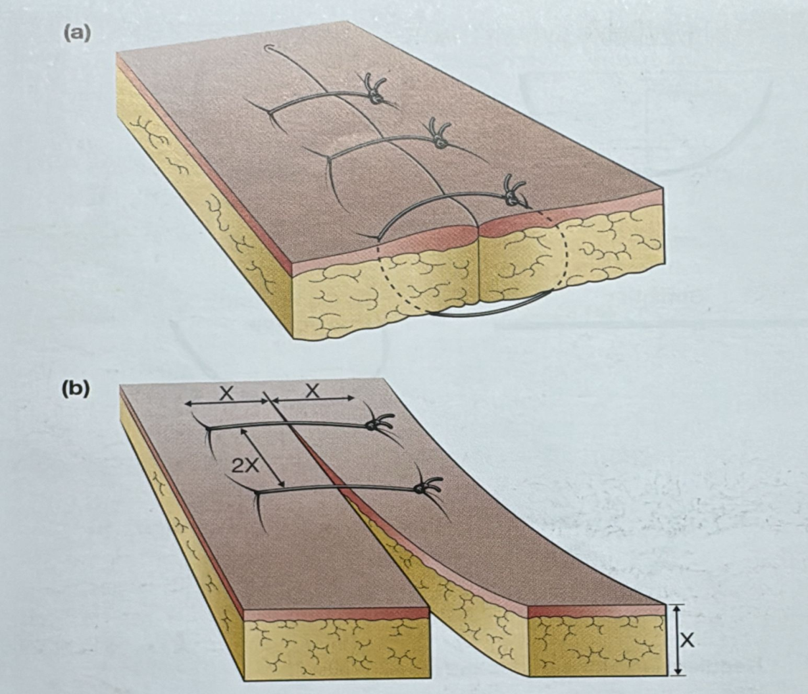
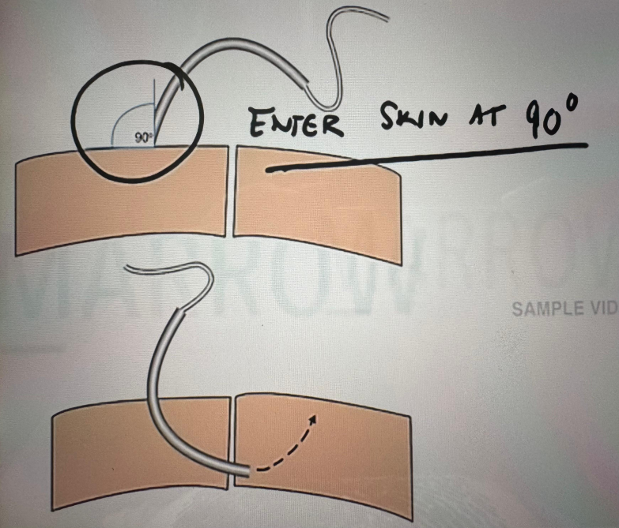
Simple interrupted sutures
USES : Skin
Linear wounds

Slide 17
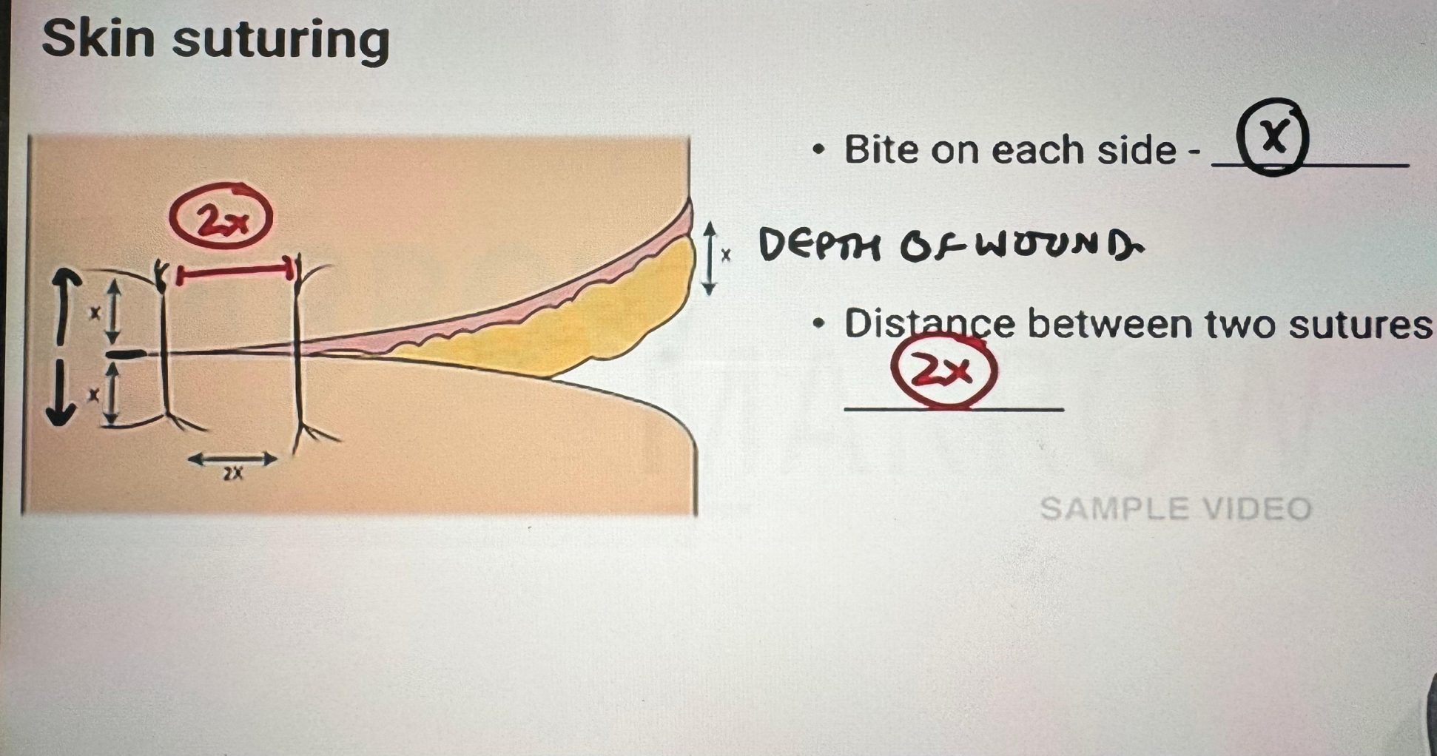

Slide 18
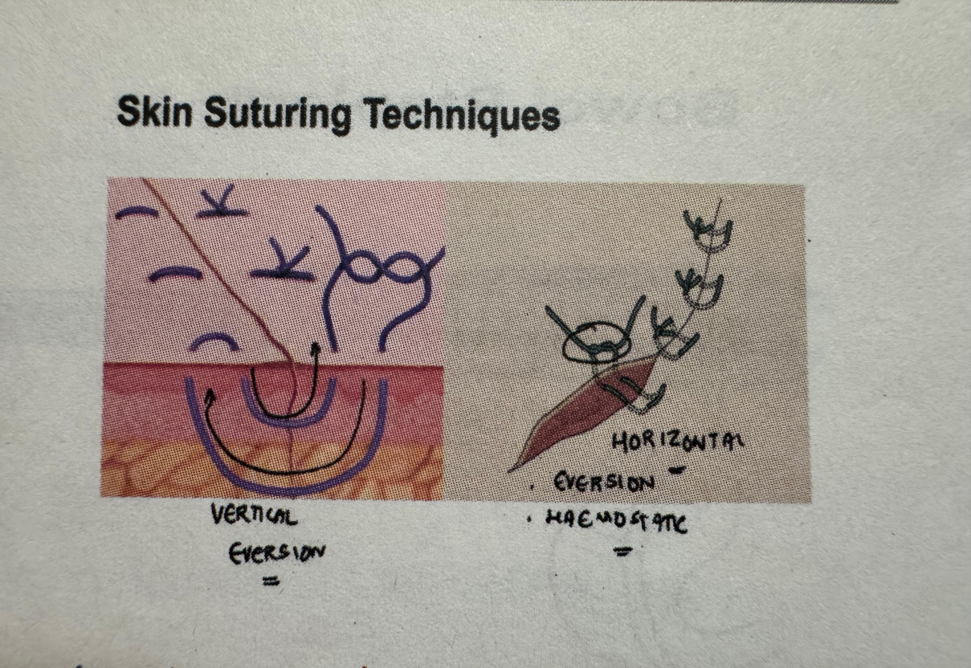
Mattress sutures
2 types of mattress sutures
Vertical Horizontal

Slide 19
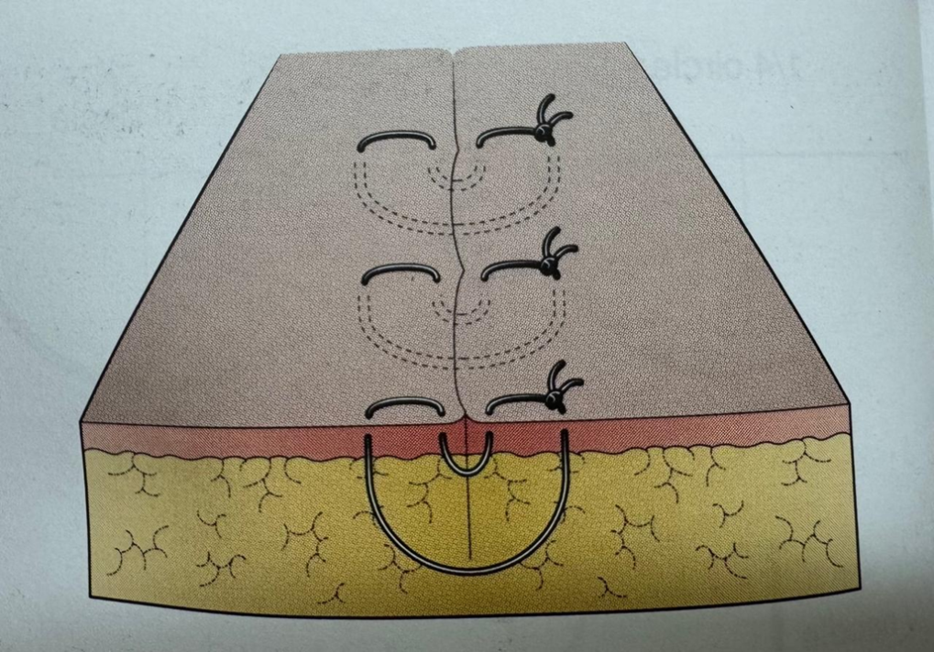
VERTICAL MATTRESS SUTURES
USES:
In producing accurate approximation of wound edges causing eversion .
Especially when the edges to be anastomosed are irregular in depth or disposition .
If simple sutures failed to cause eversion of the skin .

Slide 20
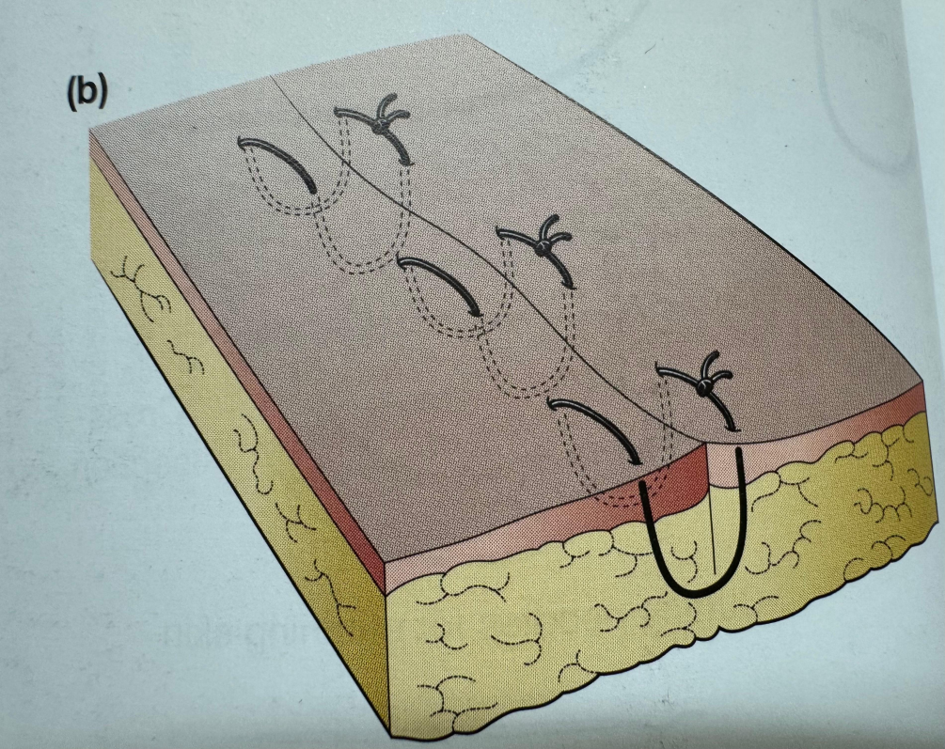
HORIZONTAL MATTRESS SUTURES
USES :
Tension sutures
Facial closure
It has least cut through rate .

Slide 21
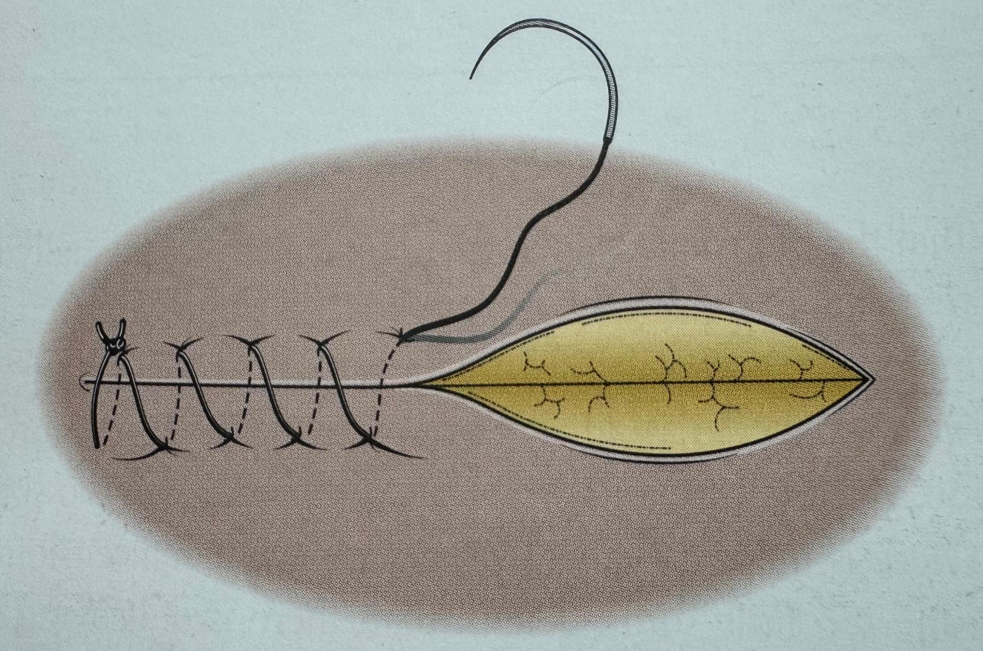
CONTINUOUS SUTURES
USES :
Peritoneum
Fascia
Aponeurosis

Slide 22
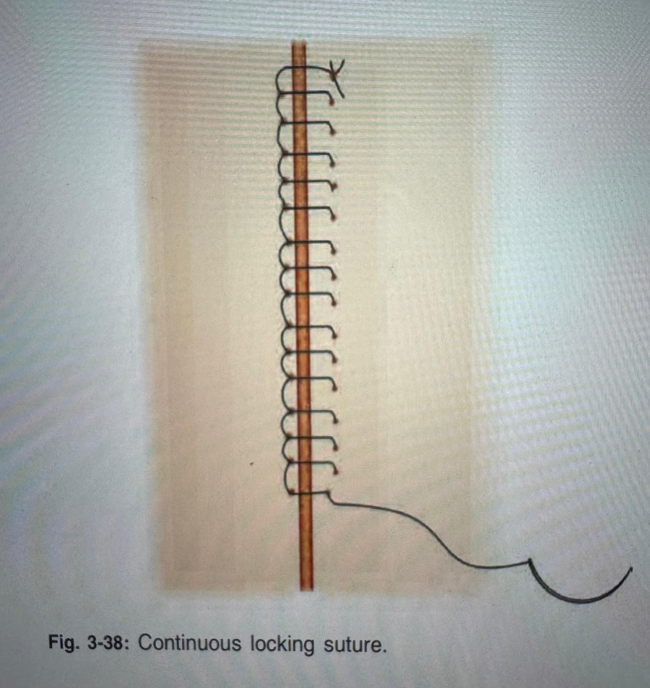
CONTINUOUS INTERLOCKING SUTURES
USES :
To achieve haemostasis
It holds the tissue well
Closure of rectus sheath,
Cesarean section for uterus closure
In bowel anastomosis .

Slide 23
SUBCUTICULAR SUTURES
USES :
For skin closure
Cosmetic appearance
Where skin edge approximated easily
For non – absorbable (Prolene 3-0 ) sutures ends are secure using a collar and bead / tied loosely over the wound
For absorbable ( Monocryl 3-0 ) sutures ends should be secured using a buried knot
Curved cutting needle is used
If > (3-0) will cause inflammatory reaction in the apposed wound
C/I - trauma , infective areas , emergency surgeries

Slide 24
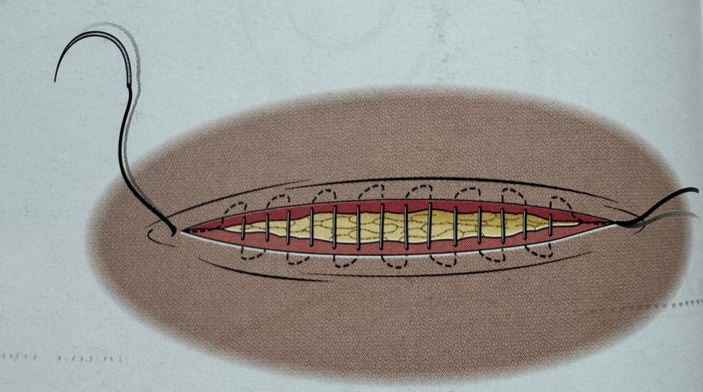
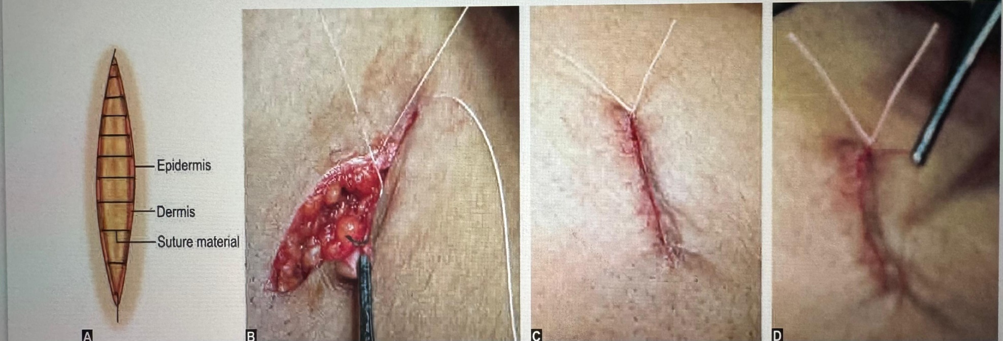
SUBCUTICULAR SUTURES

Slide 25
SKIN STAPLERS
It is stainless steel staplers applied using specialized disposable to the skin
USES :
Skin approximation .
It is quicker and apposes well giving good cosmetic results
Relatively expensive
Saves operative time

Slide 26
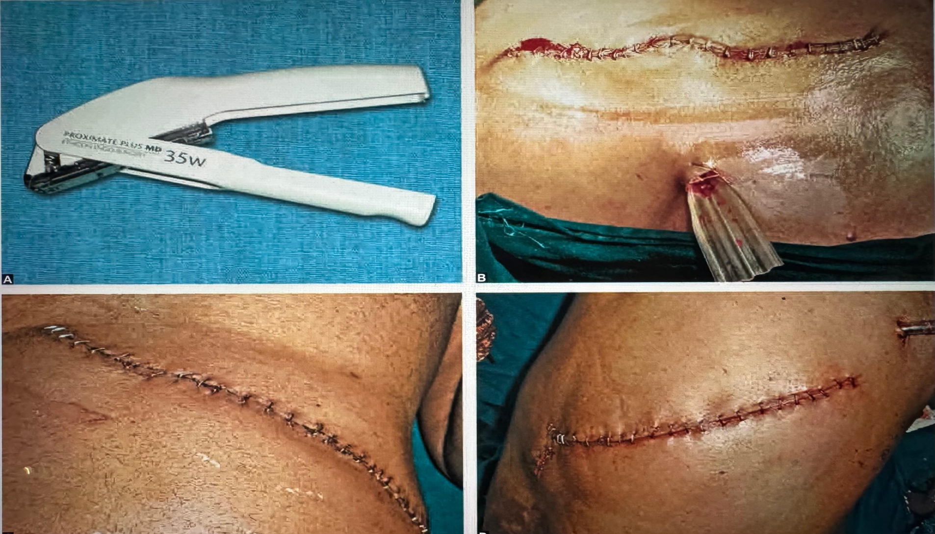
SKIN STAPLERS

Slide 27
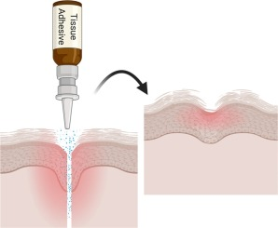
TISSUE GLUE
USES :
Primary tissue apposition
Adjunct to sutures
For clean incised wounds
Skin crease incisions
Wounds not under tension .

Slide 28
REMOVAL OF SKIN STAPLES OR SUTURES
SCALP – 7 days
FACIAL 5 -7 days
NECK 5-7 Days
THORABDOMINAL - 8-10 days
IMMUNOCOMPROMISED , DELAYED WOUND HEALING ,OVER JOINS AFTER 12 - 14 Days )

Slide 29
WHEN TO OPEN THE DRESSING
AFTER 72 HOURS CHECK DRESSING for a clean incised wound
If the wound is infected , daily dressing should be done
IF FEVER ,PAIN, SOAKAGE of dressing +
Open the dressing - COLLECTION – DRAIN

Slide 30
SALIENT POINTS OF SUTURING
Gap between the suture should be equal Skin ( 1cm ) Bowel ( 3-5 mm) Vessel (1-2 mm )
2. Slight eversion of the wound edge causes proper apposition
3. Deeper bite in the tissue by the needle should be wider than superficial to achieve adequate eversion
4. Bites should be adequate and deep enough ; superficial unequal bites will cause improper apposition
5. Inversion of edges may cause overlapping , delayed healing , delayed wound gap and poor scarring
6. More tension with abnormally tight suture will blanch the skin causing obvious suture mark
7. Flap of the tissue / skin when sutured , knot should be on the opposite side of the edge of the flap
8. Least tissue trauma , atraumatic handling , optimum precision are the need .

Slide 31
Thank you !

